Slide 1
Azure Fundamentals
Building Cloud Native Applications in Azure

Slide 2


Meet Your Instructors
Dustin Ewers
Steve Hirscher
Architect: Retirement
12+ years experience
Speaker / Writer
Architect: Consumer
15+ years experience
5+ years at CUNA

Slide 3
CUNA Cloud Adoption
Today Build Competence
2019 Cloud First
2020 Cloud Only
2021 All in the cloud
Notes:
The cuna cloud adoption as three phases.
Build competence in cloud technologies | We don’t have standards yet, so we need to make them.
Cloud first - cloud if you can
Cloud is the default
Cloud for everything - Move / Rearchitect and Migrate into the cloud
We’re focusing on #1

Slide 4
Course Goals
Learn About Azure Services
Learn How to Interact With Azure
Build Applications Using Azure
Notes:
This is going to be a more hands on course.
This is a general Azure course. Not a specific “standards” course. A standard hasn’t emerged yet.

Slide 5
Roadmap
Azure Basics
Azure Storage
Azure Batch Processing
Azure App Hosting
Messaging
Security
Cost Management

Slide 6
Logistics
Modules
Lecture + Labs
Breaks: During the Lab Time
Pair / Group (if you want)
Ask Questions

Slide 7
Azure Basics

Slide 8
How Do I Organize my Stuff?
Subscriptions
Resource Groups
Tags
Notes:
Subscriptions - top level construct, per dept, per company, etc..
Resource Groups - used to organize different services, per application
Tags - can be used organize cross cutting concerns and report on different usages

Slide 9
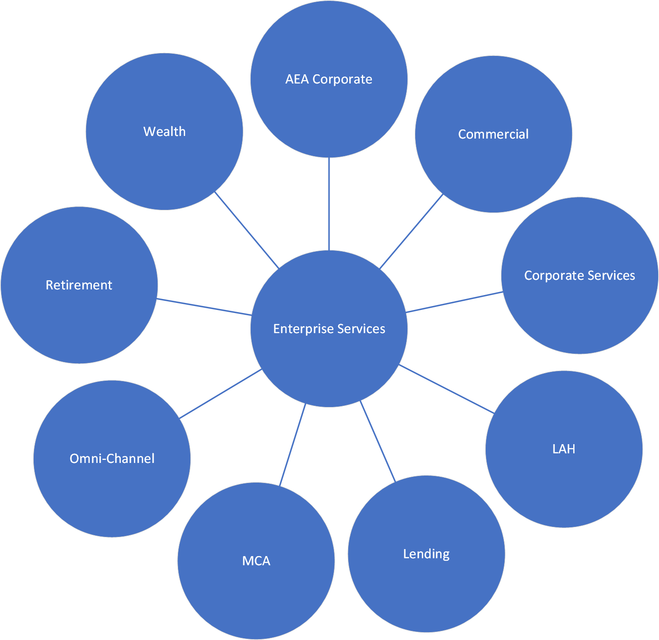
CUNA Subscription Model
Prod and Non Prod Subscription Per Portfolio

Slide 10
Retirement-NonProd
Retirement-Prod
RG-App1
Web App
SQL DB
vNet
RG-App2
Func App
Cosmos DB
RG-App1
Web App
SQL DB
vNet
RG-App2
Func App
Cosmos DB
Tag1
Tag1
Tag1
Tag1

Slide 11
How do I use it?

Slide 12
Infrastructure As Code
Infrastructure for the projects lives with the project
Repeatable infrastructure
No more waiting 1+ mo for an environment.

Slide 13
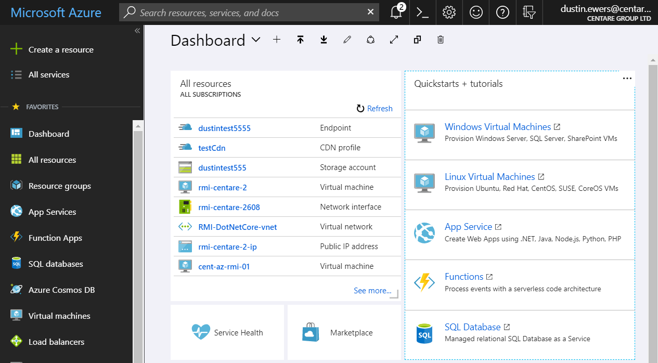
Azure Portal
Notes:
The portal is great for exploring
Not so great for automation
portal.azure.com
<shell out to the portal and take a look around>

Slide 14
Azure CLI
az group list
az group --help
az group list --output table
Command Format: az <resource type> <action> <options>
Add --help or -h for assistance
Format output using -o or --output
(valid outputs include table and tsv)
Notes:
CLI is the new default
Great for automation
Local install
shell.azure.com

Slide 15
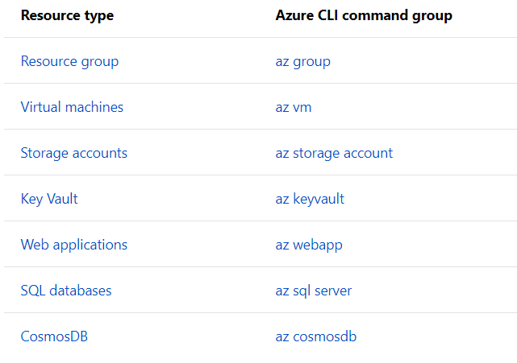

Slide 16
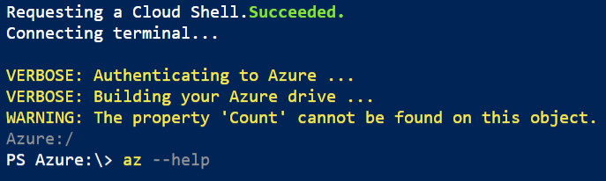
Notes:
Use the AZ help command to get documentation

Slide 17
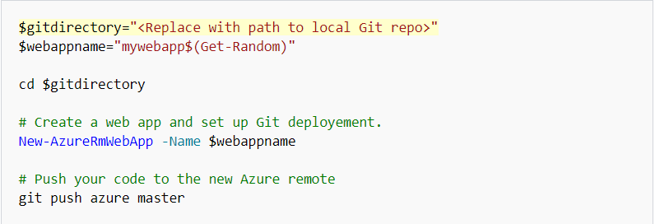
Azure Powershell
Notes:
Certain parts of powershell have been depreciated, use the CLI

Slide 18
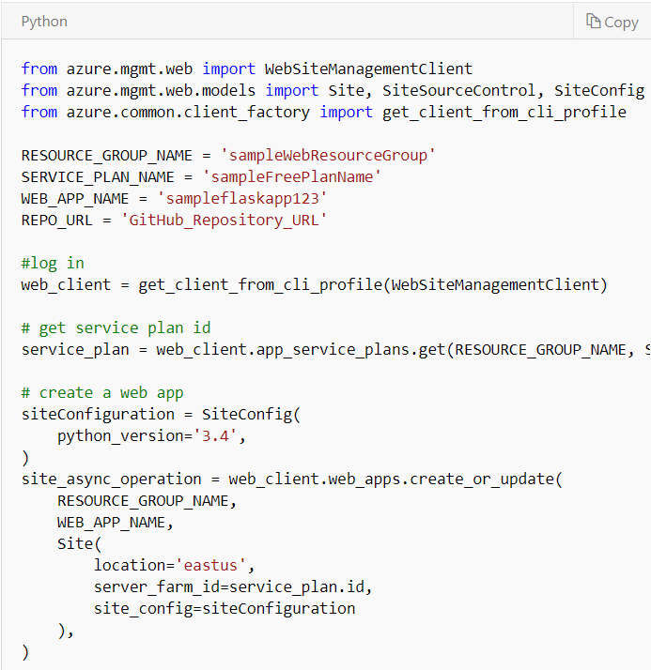
Azure SDK
Notes:
These client libraries are built on top of the REST API

Slide 19
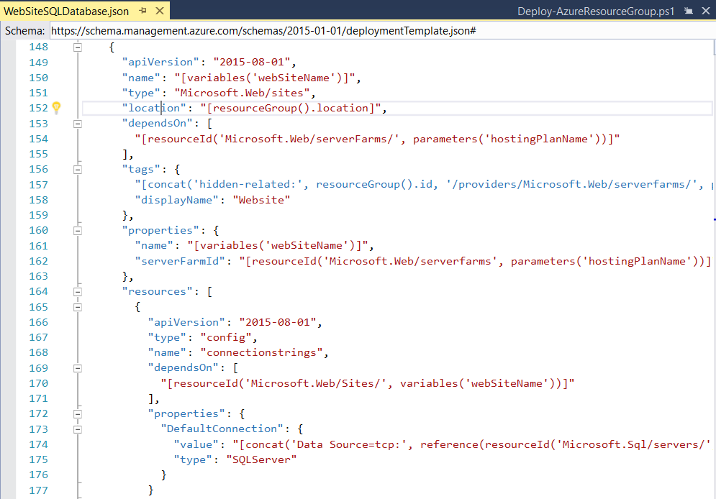
ARM (Azure Resource Manager) Templates

Slide 20
Azure Credits
MSDN - (Visual Studio Enterprise)
Azure Trials
Pay As You Go

Slide 21
What can I build?

Slide 22
Virtual Infrastructure (IaaS)
VMs
Network Resources
Firewalls
Load Balancers
Virtual Networks
GPU clusters
CDNs (Content Delivery Network)

Slide 23
App Services
Azure Kubernetes Service
Azure Service Fabric
Azure App Service Plans
Azure Functions

Slide 24
Batch Processing
Web Jobs
Azure Batch
Azure Data Factory
SQL data Warehouse

Slide 25
Data Storage
Azure Storage Accounts
Cosmos DB
Azure SQL
REDIS Cache
Azure Key Vault

Slide 26
Messaging
Storage Queues
Service Bus
Event Hub
Event Grid

Slide 27
Apis / Services
Azure Active Directory
Cognitive Services
Azure Bot Services
Application Insights
Mobile App Center
Logic App

Slide 28
Lab Notes
Track Your Steps
You Might Get Stuck
Ask for Help
Notes:
Track Your Steps
Use Visual Studio Code
It has an integrated shell and you can keep track of your commands
You Might Get Stuck
If you miss a step, backtrack and make sure you did everything okay.
People miss steps all the time
Ask for Help
Start off by asking your neighbor, then raise your hand and we will help you out
Asking your neighbor is good for them as well as for you.

Slide 29
Lab: Explore the Portal and Azure CLI
https://github.com/centaretraining/azuretraining
Notes:
Mention scrolling down
Also demo some stuff in PowerShell

Slide 30
Azure Storage

Slide 31
Storage Accounts
Blobs
Tables
Files
Queues
Notes:
Blobs - Binary large objects. Used for files, images, etc…
Tables - NoSQL Key/Value store
Files - SMB file shares, use blob storage
Queues - simple cloud messaging, use service bus instead
https://docs.microsoft.com/en-us/azure/service-bus-messaging/service-bus-azure-and-service-bus-queues-compared-contrasted

Slide 32
Storage Account Options
Performance Tiers - Standard, Premium
Access Tiers - Hot, Cool, Archive
Encryption - done by default
Notes:
Performance Tiers:
Standard
Premium
Access Tiers:
Hot - frequently accessed
Cool - stored for at least 30 days
Archive - stored for at least 180 days, latency measured in hours

Slide 33
Storage Redundancy
Locally Redundant (LRS): Same Datacenter
Zone Redundant (ZRS): Same Region
Geo-Redundant (GRS) - Different Regions
Notes:
Locally Redundant (LRS): Same Datacenter | 11 9’s
Zone Redundant (ZRS): Same Region | 12 9’s
Geo-Redundant (GRS) - Different Regions | 16 9’s
https://docs.microsoft.com/en-us/azure/storage/common/storage-redundancy

Slide 34
Azure Databases
Azure SQL Database
SQL Server on VMs
Azure MySQL
Azure Postgres
Azure MariaDB

Slide 35
Azure SQL Database
Managed SQL Server DB
Feels like On Prem SQL Server
Pricing Tiers - DTUs, vCores
Encrypted by Default (TDE)
Firewalled by Default
Notes:
Managed SQL Server DB
Feels like On Prem SQL Server | Dev XP is just like a normal SQL Server
Pricing Tiers - DTUs, vCores | DTUs are increments of compute and memory. You can either get a set amount or an elastic pool of DTUs
vCores are more granular
Encrypted by default using transparent data encryption.
Firewall - comes with it’s own firewall that you can configure to limit incoming connections
https://docs.microsoft.com/en-us/azure/sql-database/transparent-data-encryption-azure-sql?view=sql-server-2017
https://docs.microsoft.com/en-us/azure/sql-database/sql-database-purchase-models

Slide 36
Cosmos DB
Globally Distributed
NoSql DB
Multiple APIs (Mongo, Cassandra, Gremlin)
Crazy Fast

Slide 37
Azure Cache for Redis
Managed Redis Instance
In-memory Datastore
Built in Firewall
Tiers - Basic, Standard, Premium
Notes:
Managed Redis Instance
In-memory Datastore
Tiers -
Basic - For development and experiments
Standard - for light development
Premium - includes more throughput, but more importantly, more security
https://docs.microsoft.com/en-us/azure/azure-cache-for-redis/cache-premium-tier-intro

Slide 38
Service | Use it for...
Storage Accounts | File Storage (Blobs)
Azure SQL | Relational Databases
Cosmos DB | NoSQL, Highly Scalable
REDIS | Caching

Slide 39
Lab: Let’s Make a SQL Database

Slide 40
App Service Plans

Slide 41
App Service Plans
App hosting
Based on a group of VMs
Autoscale
Auto backups

Slide 42
App Service Plans
Supports: .NET, .NET Core, Node.js, etc…
Web Apps
API Apps
Function Apps
Webjobs
Tiers: Basic, Standard, Premium, Isolated
Notes:
Lots of supported languages: PHP, Ruby, Java, Python, .NET, .NET Core, Powershell (as a batch process)
Tiers: Basic, Standard, Premium, Isolated
Higher tiers = better machines and more features
Basic = dev / test
Standard = prod
Premium = Standard plus more backups / features
Isolated = ASE, super expensive

Slide 43
Security
Built in Auth Available (Including AD)
Automatic Server Patches
Azure Key Vault Integration
IP Filtering
vNET Compatibility

Slide 44
Scenario
We have a ASP.NET MVC application
We have a Web API backend
We need some batch jobs
We need a SQL Database
We’d like to cache responses

Slide 45
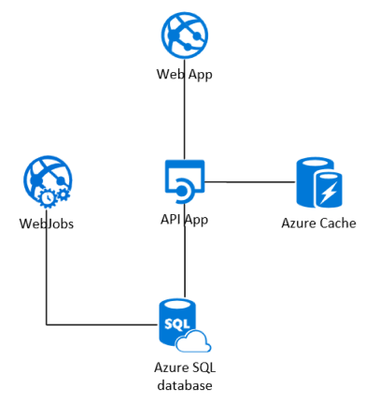
Notes:
Note how this isn’t much different than what you’re used to...

Slide 46
Lab: Let’s Deploy an Web Application on App Services

Slide 47
Containers on Azure
Docker, Kubernetes, and AKS

Slide 48
VMs vs. Containers
Virtual Machines
Containers
Application
Application
Bins/Libraries
Bins/Libraries
Application
Application
Guest OS
Guest OS
Bins/Libraries
Bins/Libraries
Hypervisor
Container Engine
Host OS
Host OS
Server
Server
Notes:
Containers don’t have a full OS for each container, which saves space

Slide 49
Layered Containers
Container Image
Application Artifacts (your app)
Common Hardening / Configuration
Reusable
Application Platform (ex - .NET Core)
Base Image (ex - Alpine Linux)

Slide 50
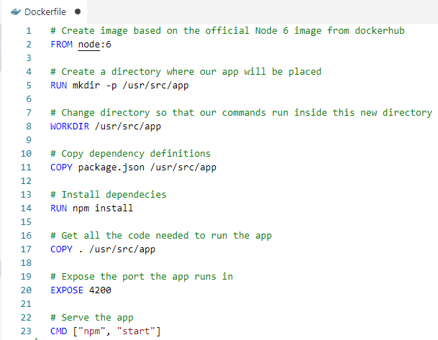

Slide 51
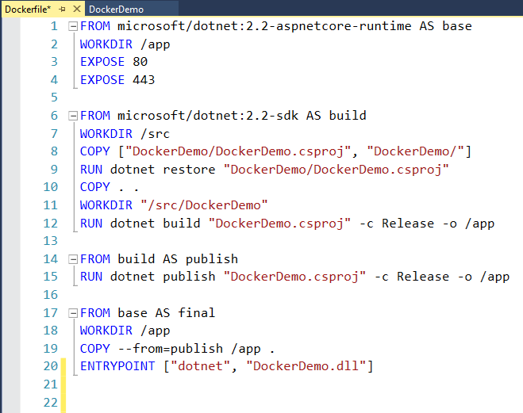
Image: Build the Application
Image: Run the Application
Notes:
Default .NET Image
Multi Stage Build Pattern
Layering Images to reduce the size and attack surface of the final image

Slide 52
How to do we run an image?
Notes:
Just straight up Docker or…

Slide 53
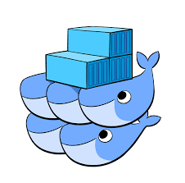
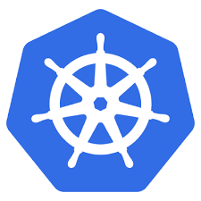


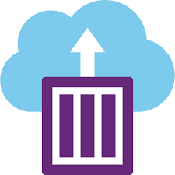
Orchestration
Docker Swarm
Kubernetes
Mesos
Service Fabric
Azure Container Instances
Notes:
Orchestration is the software that manages your containers and makes them into a whole application.
There’s tons of different ways to run Docker containers.
Every cloud provider has their own orchestration offering

Slide 54
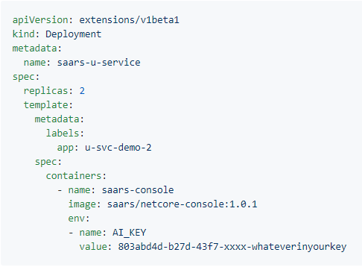
Kubernetes
Kubernetes
Created by Google
Datacenter in a box
Desired State Configuration
Notes:
Instead of running scripts to determine what your data center looks like, you tell it what you want and it gives it to you.
File Source:
https://github.com/Microsoft/ApplicationInsights-Kubernetes/wiki/Getting-Started-for-.NET-Core-Applications
https://kubernetes.io/docs/concepts/workloads/pods/pod-overview/
https://kubernetes.io/docs/concepts/workloads/controllers/deployment/
https://kubernetes.io/docs/concepts/services-networking/service/

Slide 55
Kubernetes Organization
Pods
Deployments
Services
Notes:
Pods - smallest deployable unit | Generally one container (and maybe a sidecar to go with it)
Deployments - groups of Pods | manages things like scalability
Services - Networking between groups of Pods

Slide 56
What can you run using Docker / Kubernetes?
Applications (Obviously)
API Gateways
Databases
Logging and Monitoring Frameworks
etc...
Notes:
There’s probably a docker container for everything you want to do
The only caviat is you don’t want to store state in Kubernetes
----
Docker / Containers are really good for experimentation. You can easily fire up stuff and play with it without having to install a bunch of junk on your machine.

Slide 57
Cloud Native Interactive Landscape
https://landscape.cncf.io/
Notes:
Kubernetes is at the center of a whole cloud native ecosystem.
It has all sorts of stuff...

Slide 58
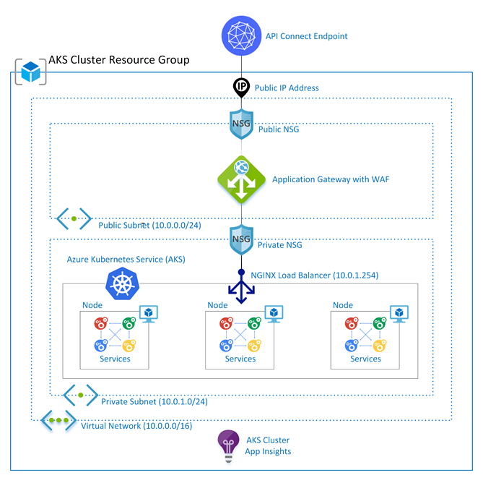
Titan
Notes:
CUNA Team AKS offering that deploys an Azure Kubernetes Service instance with a bunch of security around it…
Implements nearly 200 controls for you

Slide 59
Scenario
.NET Core Microservices
A static React Frontend
SQL Database

Slide 60
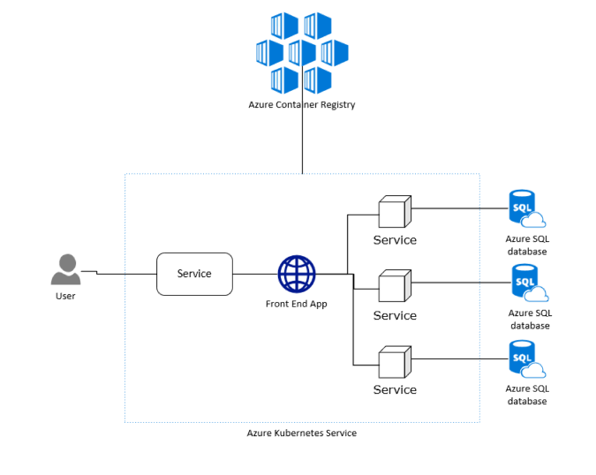
Notes:
five microservices
five SQL databases
one front line service in React

Slide 61
Serverless On Azure

Slide 62
“The Cloud” is just someone else’s computer.
… and sometimes you don’t have to see that computer

Slide 63
Serverless on Azure
Azure Functions
Logic Apps
Azure Storage
Cosmos DB
Azure Active Directory
Service Bus
Notes:
https://azure.microsoft.com/en-us/overview/serverless-computing/#explore-azure-serverless-apps

Slide 64
Azure Functions
Serverless APIs
Can be stateless or stateful (Durable Functions)

Slide 65
Scenario
MVP Web App
Relatively Simple Backend

Slide 66
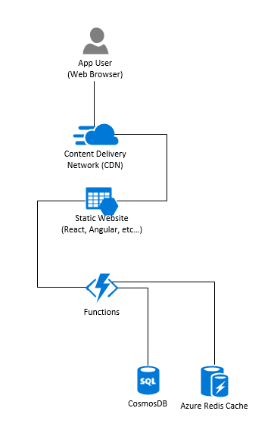

Slide 67
Scenario
Vendor File Processing

Slide 68
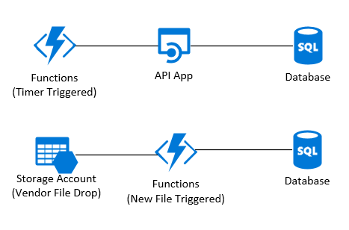

Slide 69
Lab: Let’s Build a Serverless App

Slide 70
App Service Plans | Kubernetes | Serverless
Most like your current setup | Easy to make use of best practice deployment patterns | Good for batch processes and small workflows
Supports .NET and .NET Core (and lots of other languages) | No full .NET support (yet) | Can get complicated for full apps

Slide 71
Discussion: Compare / Contrast Services

Slide 72
Azure Messaging

Slide 73
Message Brokers
Storage Queues
Service Bus
Event Hub
Event Grid
Notes:
There are other ways to message apps too, like a database or a file, but these are the main service offerings in Azure

Slide 74
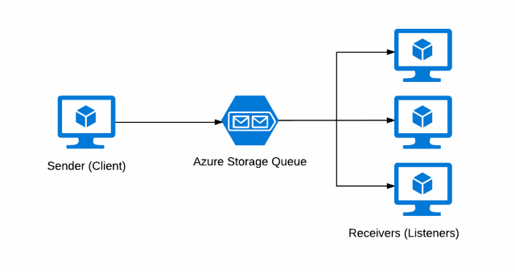
Storage Queues

Slide 75
Storage Queues
Large storage limit (>80GB per queue)
Messages can be updated in the queue
Inexpensive
No long polling
Small message size limit (64KB)
No pub/sub or advanced features
Notes:
Note that you could extend the message size by including extra data in BLOB storage.
You could do this with other queues too, but you already have a storage account in this case

Slide 76
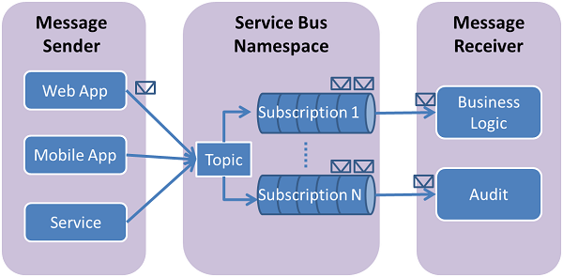
Service Bus
Notes:
Has queues like storage queues, but also has the concept of topics and subscriptions

Slide 77
Service Bus
Larger message size limit (1MB in Premium tier)
Supports topics and subscriptions
AMQP or long polling over HTTP
VNet support
Advanced features (sessions, dead-lettering, scheduled delivery, FIFO, dupe detection...)
More complicated to configure/manage
No push delivery
Generally slower and more expensive
Hourly + usage costs

Slide 78
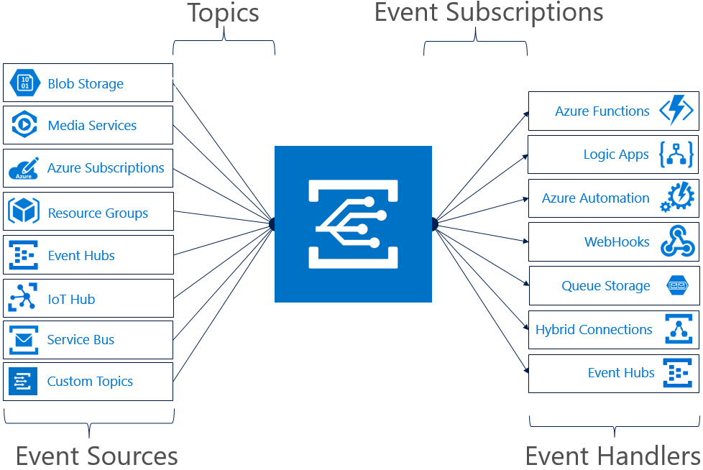
Event Grid

Slide 79
Event Grid
Massive throughput (at least 5K messages per second, capable of 10 million per second per region)
Built in events from many Azure services
Integrations with several different Azure services as subscribers
Fully managed service
HTTP push based delivery
Pay-per-use pricing
Very small message size limit (64KB)
Multi-tenant system
Push based - querystring based “security”
Required message format
Notes:
Has a pre-defined message format you ahve to follow
but - supports an open event message standard (not on by default)

Slide 80

Event Hub

Slide 81
Event Hub
Extremely high throughput (1MB/sec ingress, 2x egress per throughput unit)
Integrations with Storage Accounts (Event Hub Capture) and Stream Analytics
Kafka client support
Consumer must manage the offset
Competing consumer model doesn’t really work
Notes:
Has a pre-defined message format you ahve to follow
but - supports an open event message standard (not on by default)

Slide 82
Which to pick?
Storage Queues
Apps that need basic message queueing and already have an established storage account.
Apps that just need to queue up file processing
Event Hub
“Big Data in Motion”
Event streaming - Telemetry, IOT
Event Grid
Responding to and processing Azure events
Web hook systems
When the processing is serverless (Azure Functions)
Service Bus
Discrete business events

Slide 83
Scenario
We have an application that processes a credit card. This card processor takes up to several minutes to do it’s work.

Slide 84
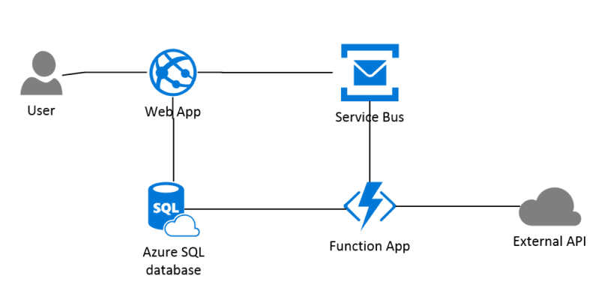

Slide 85
Lab: Messaging with Azure Service Bus

Slide 86
Azure Networking

Slide 87
Components
Virtual Networks (VNets)
Subnets
IP Addresses
NICs
Network Appliances
Notes:
Not just for IAAS

Slide 88
VNets & Subnets
Virtual Networks
A private address space (10.0.0.0/24)
Scoped to a single region
Subnets
Segments the network
IP Addresses
Public or private
Public IPs can be dynamic or static
Notes:
Know your CIDR notation (just use a subnet calculator)

Slide 89
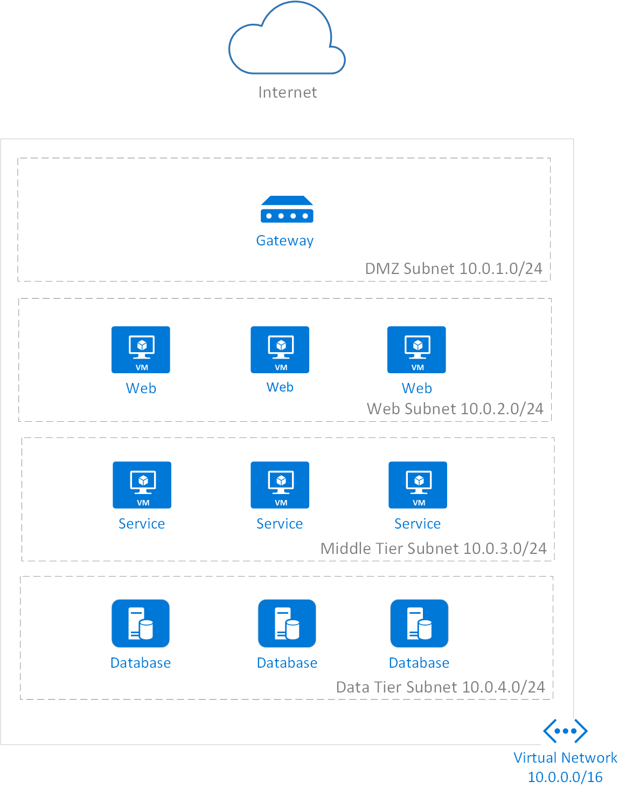
Subnet Segmentation
Notes:
Not a real setup, wouldn’t need an entire /24 (256-5 addrs) for DMZ
Also, fairly basic
Didn’t put in details, may have load balances/firewalls between each

Slide 90
Routing Traffic
VNet Peering
Route traffic between VNets
VPN Gateways
Route on-prem network over the internet
ExpressRoute
Route on-prem network over dedicated line
Service Endpoints
Route to cloud service within Azure network
App Service VNet Integration
Route from App Service to VNet within Azure network

Slide 91
Network Appliances
Azure Firewall
Azure Load Balancer
App Gateway
API Management
Network Virtual Appliances (NVAs)

Slide 92
Azure Firewall
Typically used for securing traffic between networks
Stateful firewall
IP, Port, Protocol based filtering
Domain name filtering
NAT support
Microsoft Threat Intelligence

Slide 93
Azure Load Balancer
More IAAS focused load balancing generic traffic IP, Port, Protocol based filtering
Domain name filtering
NAT support
Application agnostic load balancing
Not protocol specific (supports UDP)
Notes:
You could do UDP load balancing with this
There are better tools for security and load balancing ingress web traffic

Slide 94
Application Gateway
HTTP load balancer, reverse proxy, and layer 7 gateway
Web app firewall (OWASP)
Load balancer
SSL termination
URL based routing
Request rewriting

Slide 95
API Management
HTTP service gateway meant for publishing APIs to consumers
Service catalog
Subscription management
Mock responses
Request/Response rewriting
API versioning

Slide 96
Cloud Security

Slide 97
Roadmap
The shared responsibility model
Defense in depth
Azure security
Networking
Authentication and access management
Data security and encryption
Secure an example application

Slide 98
How Secure is the Cloud?

Slide 99
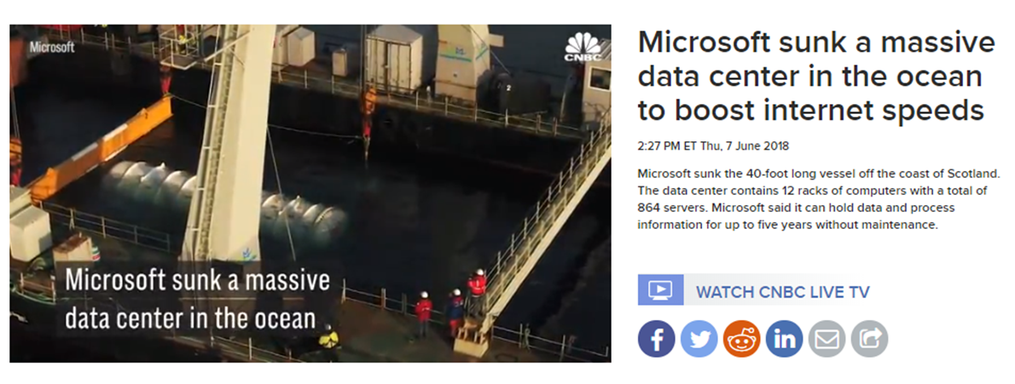
Very Secure!
Notes:
Cloud providers have way more resources than you could possibly ever have
Is your data center’s physical security better than Microsoft’s?

Slide 100
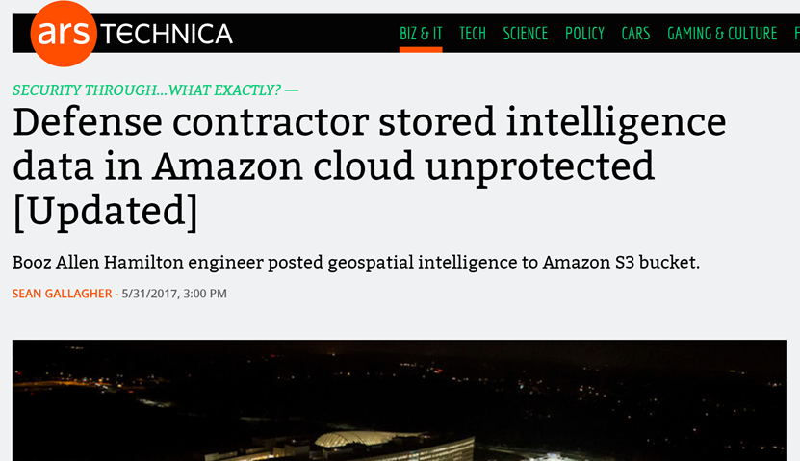
… for the things they are responsible for

Slide 101
Through 2022, at least 95% of cloud security failures will be the customer's fault.
- Gartner

Slide 102
The Shared Responsibility Model

Slide 103
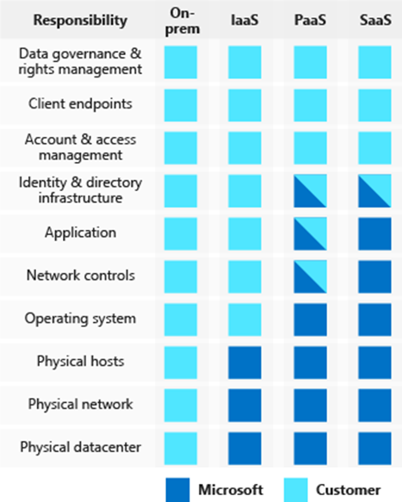
The Shared Responsibility Model
Azure is responsible for the security
OF the cloud
You are responsible for security IN
the cloud
Notes:
On premise you’re in charge of everything
-Physical access to datacenter as mentioned
-What about physical
-Are your operations people checking to make sure the hardware you are buying is secure? Are they securing the supply chain?
-AWS found out that hardware from china had chips embedded in the

Slide 104
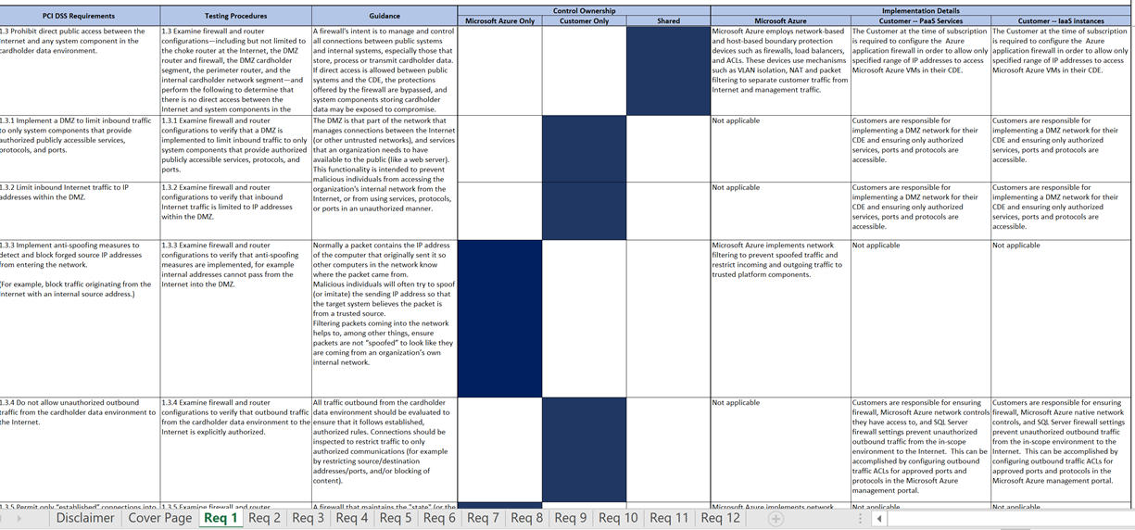
Azure Responsibility Matrix
Notes:
In your case this also includes other departments in CUNA
Operations, sec ops, infrastructure, etc have part of this responsibility
For example - If you use the Titan contaienr solution they have taken responsibility for the security of the AKS configuration and the base container images

Slide 105
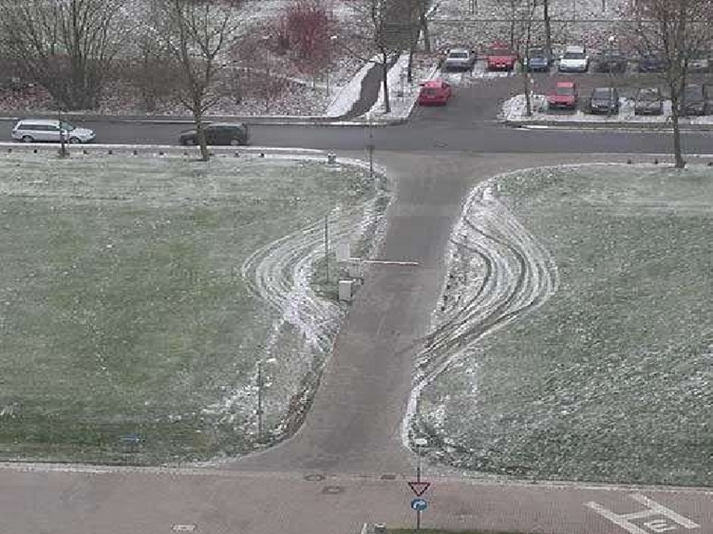
Defense in Depth
Notes:
Azure services are locked down by default
Not extremely secured, but not wide open - a storage account won’t default to public access

Slide 106
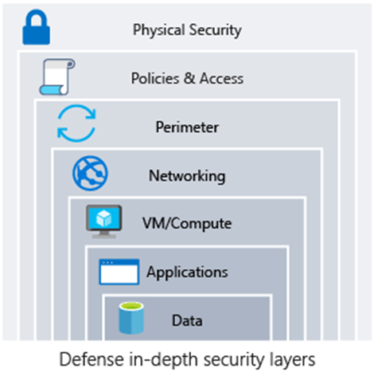
Defense in Depth
Protect every layer so that if one layer is breached, a subsequent layer is already secured to slow the attacker’s advance
Notes:
What if a hacker gets a password?
What if they breach a firewall?
What if they get a virus onto a machine in the network?

Slide 107
Security Perimeters
The security perimeter has traditionally been the network
Secure inbound ports on the firewall
Monitor all traffic from the internet
In the public cloud authentication may be your perimeter

Slide 108
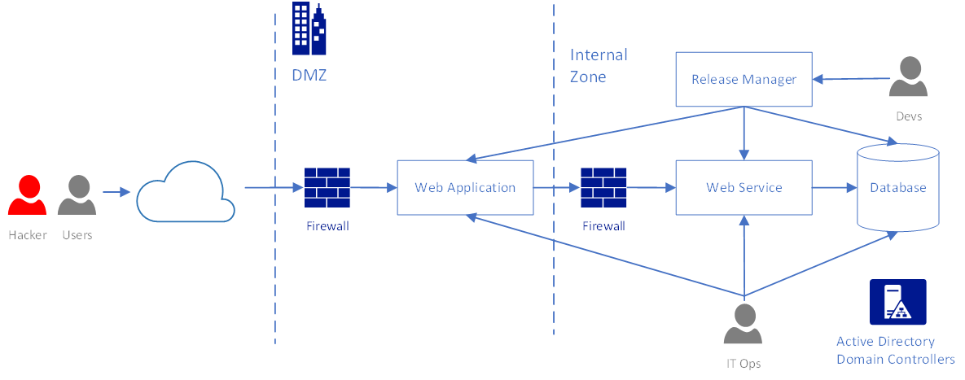
Security Perimeter - On Premise
Notes:
Once you get into those internal subnets you’re isolated
Now you shouldn’t think this way - but you may relax some our your requirements when you get to internet subnets

Slide 109
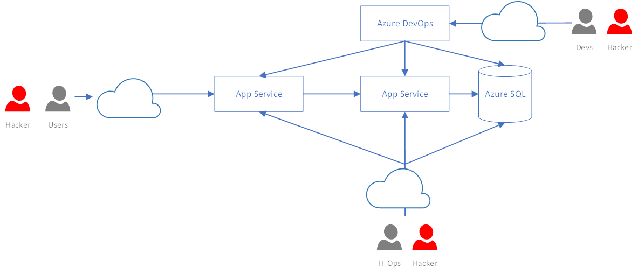
Security Perimeter - Public Cloud
Notes:
In a public cloud scenario all services are potentially accessible from the internet
Can’t do normal security practices like filtering by IP address as all resources, including IPs are ephemeral
- There are solutions to this in some cases, but can’t assume it

Slide 110
Azure Network Security

Slide 111
Network Security
Most straightforward way to secure resources: Put them in a VNet
Allows for traditional network design (routing, firewalls, subnetting, etc)
Many PAAS services support VNets
App Service Environments
Not available for some services or costs extra
Notes:
This is your traditional network security - route traffic, add firewalls and lock down ports and IP addresses
Not just for VMs

Slide 112
Network Security Groups
Like a simple firewall
Allows or denies traffic between VNet resources
Attached to either subnet or NIC
Define the source, destination, and type of traffic
Defaults to allowing all traffic within the VNet

Slide 113
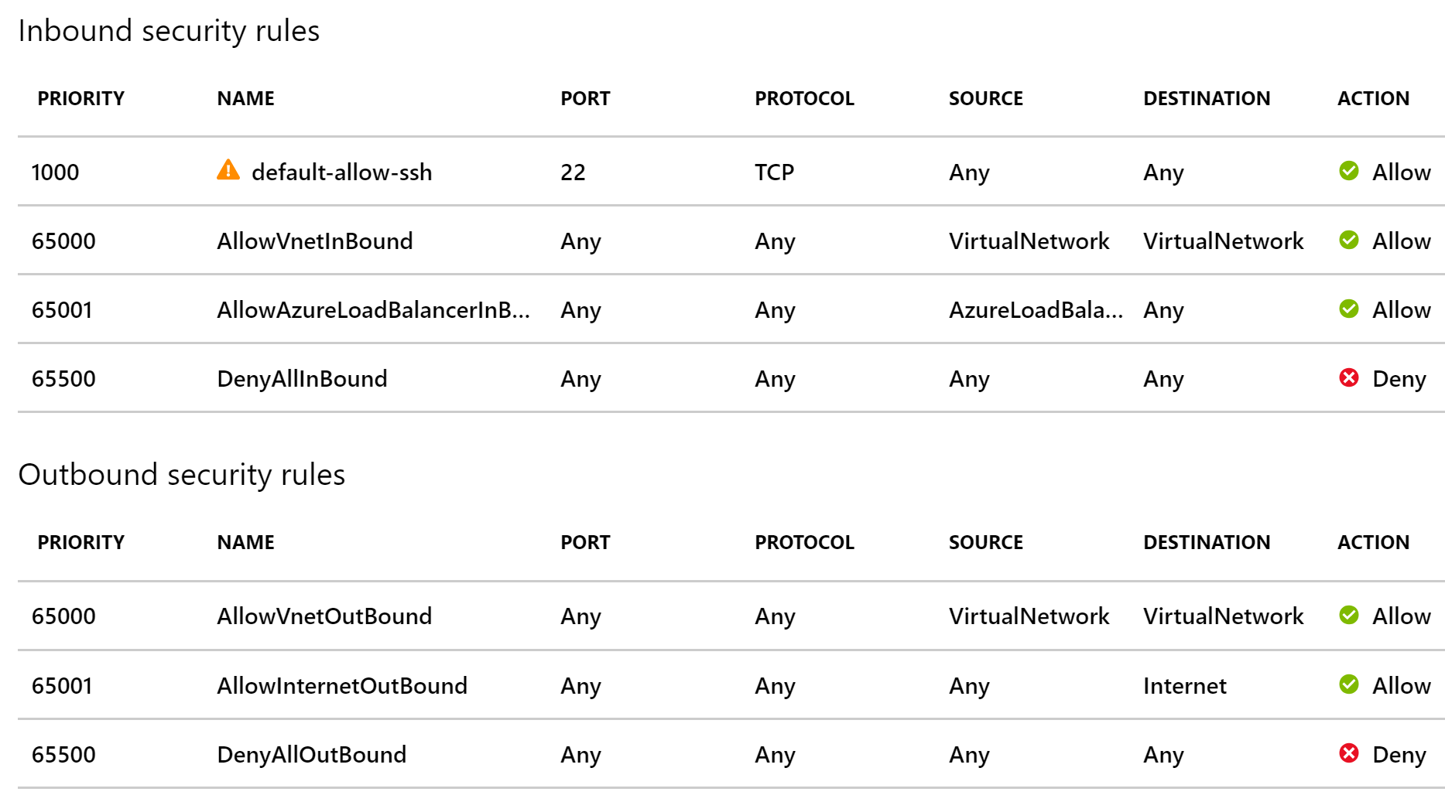
Network Security Groups

Slide 114
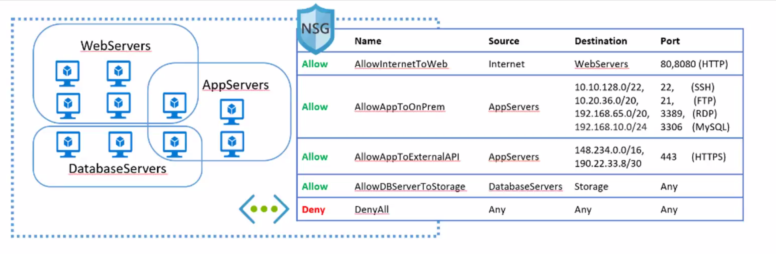
Network Security Groups
Sources and destinations:
IP addresses
Application Security Groups
Service Tags

Slide 115
Backhauling
Route traffic back through your internal network
Common for egress traffic
Use standard methods for filter ingress traffic to allowed services (e.g. web traffic)
Deny all outbound internet traffic
Route internet traffic (e.g. Windows updates) back through internal network.

Slide 116
PAAS Network Security
VNet to PAAS
Service Endpoints
IP restrictions
PAAS to VNet
App Service VNet integration
PAAS to PAAS
Route through VNet
Otherwise you must secure with authentication
Most services will at least let you lock down a service to traffic from Azure services
Notes:
Don’t discount the ability to lock down to Azure services
MS monitors their network very closely and can shut down anything that is misbehaving
Won’t stop targeted attacks, but deters against outside scanning from botnets

Slide 117
Demo: Service Endpoints and NSGs

Slide 118
Lab: Create an Application Gateway

Slide 119
Azure Identity and Access

Slide 120
Concepts and Services
Azure Active Directory
Role Based Access Control (RBAC)
Managed Service Identities
Access keys and shared access signatures

Slide 121
Azure Active Directory
Azure Active Directory is NOT the same as Active Directory
Not a replacement for on premise AD
Based on internet authentication protocols
(OAuth 2.0 / OpenID Connect)
AD can synchronize users, groups, and passwords (hashes) to Azure AD
An Azure AD instance is a tenant
Notes:
AAD is a

Slide 122
RBAC
Role Based Access Control secures access to Azure resources by assigning Azure Active Directory principals to a Role at a Scope
Example Built-in Roles: Owner, Contributor, Reader
Principals: Users, Groups, and Service Principals
Scopes: Management Group, Subscription, Resource Group, or Resource
Notes:
Authorization for Azure resource manager
So AAD is you Authentication

Slide 123
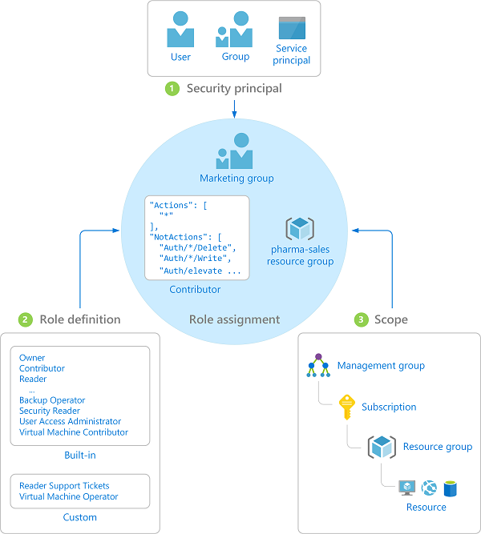
RBAC

Slide 124
RBAC
RBAC manages the Management Plane
Resources may have their own Data/Service Plane
Management Plane:
The Azure Resource Manager resource
Data Plane:
The data/application itself
Example: Securing access to add a disk to a VM vs logging into the VM

Slide 125
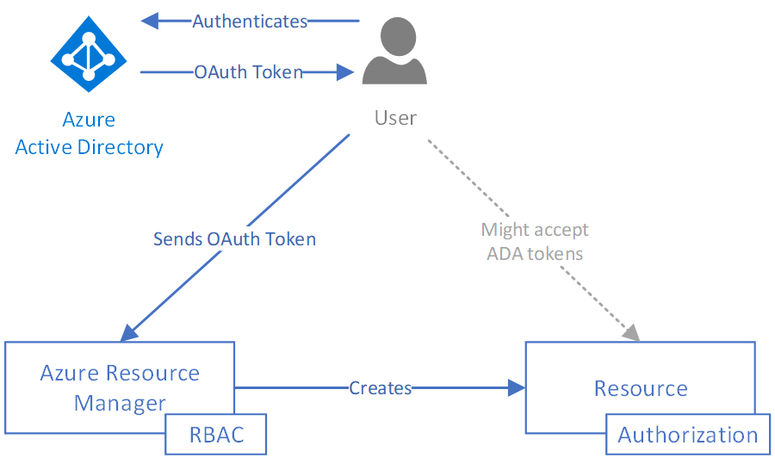
Azure AD, RBAC, and Resource Manager
Notes:
Secures access to _managing the Azure resource_
Does not necessarily secure access to the application/data itself
Microsoft is slowly implementing RBAC for some resources
Other resources might support AD authentication

Slide 126
Managed Service Identities
Managed Service Identities (MSIs) are service principals fully managed by Azure
Tied to a specific application
No storing passwords
Required for some services like Key Vault
Preview support for assigning MSI to a user managed account
Currently only system assigned – i.e. Azure creates the account for you, you can’t use an existing one

Slide 127
Access Keys and Shared Access Signatures

Slide 128
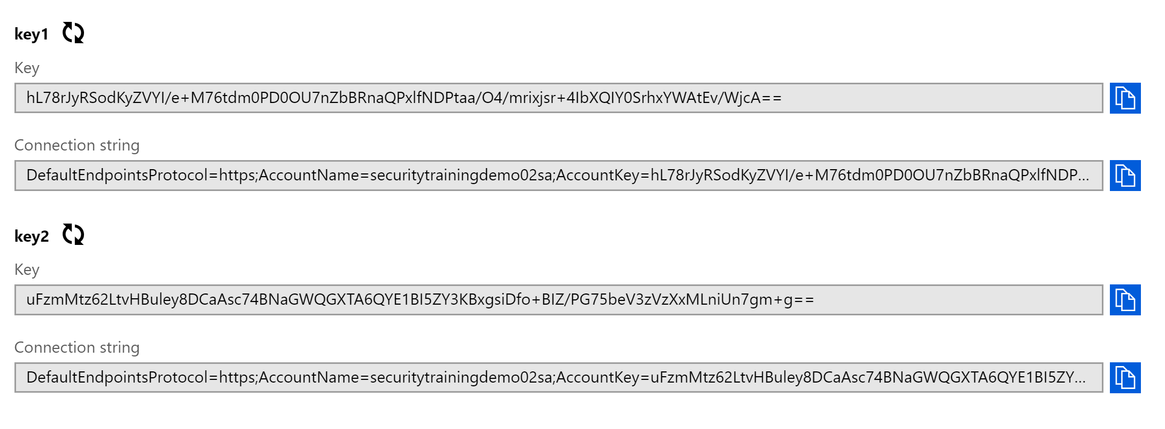
Access Keys
Access Keys are like the “root” credentials for you resource
Used by Azure Storage, Service Bus, Event Grid, Azure Search…
Passed in headers, connection strings, or URLs

Slide 129
Access Keys
You should rotate your keys frequently
Most services support 2 active keys for rotation purposes
This process should be automated, your apps should be written assuming that keys will change
Instead of storing access keys with your application, consider granting a MSI access to read the keys
Cache the key in your app for slightly less time than the rotation period
Use least privilege – only give access to read the key

Slide 130
Storage Accounts
Azure Storage has the most complex SAS model
Access Policies:
Can be used to generate SAS tokens that can be revoked
SAS tokens can be generated at the account and container level too, but this will mostly be replaced by RBAC security soon.

Slide 131
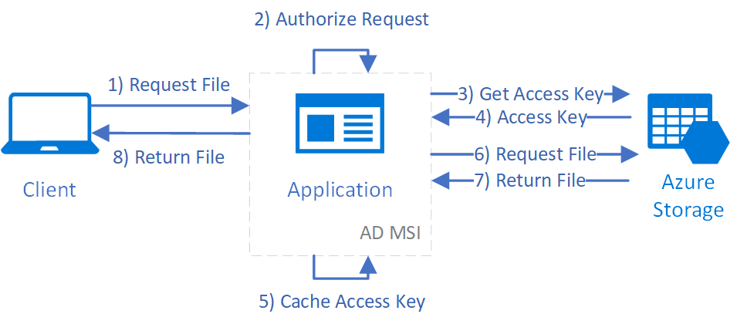
Access Key Flow
Notes:
Just a username/password

Slide 132
Shared Access Signatures
Shared Access Signatures (SAS) are tokens that delegate access to specific resources
Extremely granular:
Individual BLOB/table/queue/topic/
Specific operation (Read or Write)
Time based
Limit to specific Ips
Require HTTPS

Slide 133
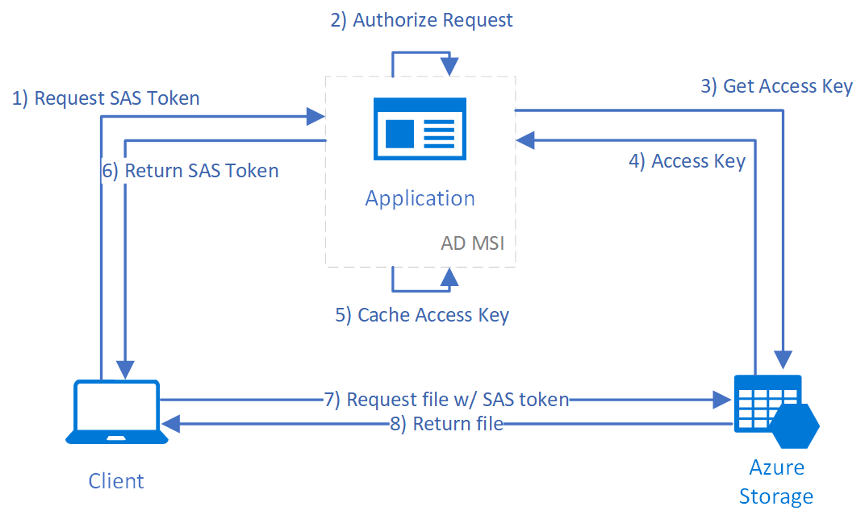
Shared Access Signature Flow

Slide 134
Lab: Storage Shared Access Signatures

Slide 135
Azure Data Security

Slide 136
Overview
Data in motion
Secret management with Key Vault
Encryption at rest
File encryption
Azure SQL security

Slide 137

Data in Motion
Always encrypt data in motion. Period.
Many services support HTTP and HTTPS
Always use HTTPS
Explicitly turn off HTTP
Notes:
Remember the architecture course?
You’re not Google, you don’t have so much traffic that SSL termination is necessary

Slide 138
Key Vault
Secure storage for:
Secrets
Encryption keys
Certificates
Secure encryption routines
Integration with numerous Azure services:
Resource manager deployments
Azure DevOps
Storage accounts
Azure SQL (Always Encrypted)

Slide 139
Data Encryption
Encryption at rest supported by almost all stateful services
https://docs.microsoft.com/en-us/azure/security/azure-security-encryption-atrest
VMs support hard drive encryption
Storage encryption
Storage Service Encryption (SSE) enabled by default
Client side encryption – Use key vault’s data key service to encrypt before sending to the cloud

Slide 140
SQL Encryption
Transparent data encryption (TDE)
Auditing
Always Encrypted
Data masking

Slide 141
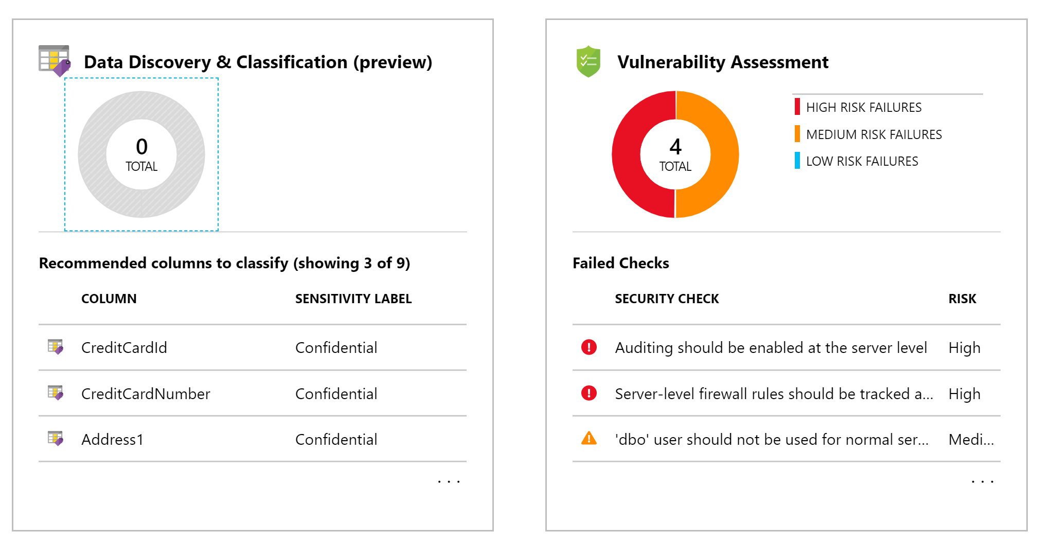
SQL Advanced Threat Detection
Advanced Threat Protection
Discovers and classifies sensitive data, manages vulnerabilities, and detecting anomalous activities
Includes compliance specific recommendations (e.g. GDPR)

Slide 142
Lab: SQL Data Security

Slide 143
Cloud Economics

Slide 144
Overview
Cloud vs on premise cost comparison
Estimating costs
Monitoring costs with
Billing dashboards
Azure Cost Management
Azure advisor
Designing cloud solutions for cost savings
Real application example
Cost risks in the cloud

Slide 145
Is the cloud cheaper than on premise?
Notes:
How many of you have some workloads in the cloud?
Were you surprised by the cost?

Slide 146
Let’s do the math
On Premise:
https://www.fusionalliance.com/wp-content/uploads/2016/07/faCloudOnPremisesFoundations.pdf
Dell R320 - $2000 or $55/month for 56 months
Power consumption: $29/month
Rack space: $10/month/sq foot = $80/month
~$164 per month
Cloud:
Azure IaaS D2 SSD instance
$208 per month

Slide 147
Let’s do the math
What about a rack of 42 servers?
On premise:
$27 (rack) +42 * $55 (capital) +42 * $29 (power) + $80 (space) _______________ $3,635 per month
Cloud
42 * $200 _______________ $8,400 per month!

Slide 148
But wait, there’s more!
Building and network security
Setup and configuration
Tax implications
Time to implement
Maintenance issues and fees
Management software
Load balancing
Redundant enterprise storage
SAN costs generally $5-$15 per GB
Cloud costs about $.10 per GB
Geo-redundancy

Slide 149
Cloud cost savings
The big advantages of the cloud come from:
Speed to market
Flexibility
Fine-Grained resource management
Other takeaways:
Replicating your data center in the cloud with IaaS is not the most cost effective option
The cloud comes with advanced monitoring and management tools, often for free

Slide 150
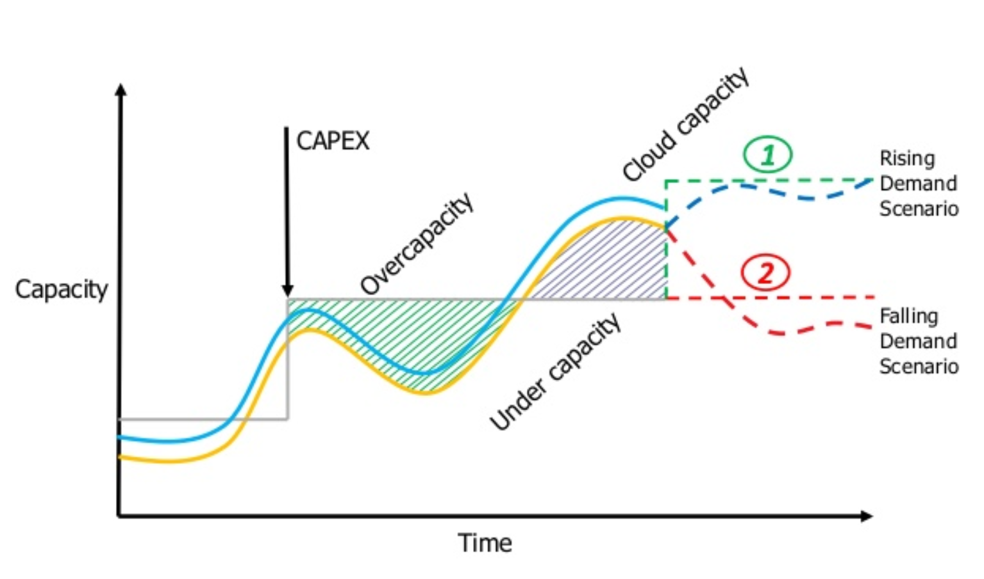

Slide 151
The good news:
A system’s design can have immediate significant effect on its operational cost

Slide 152
The bad news:

Slide 153
The bad news:
A system’s design can have immediate significant effect on its operational cost

Slide 154
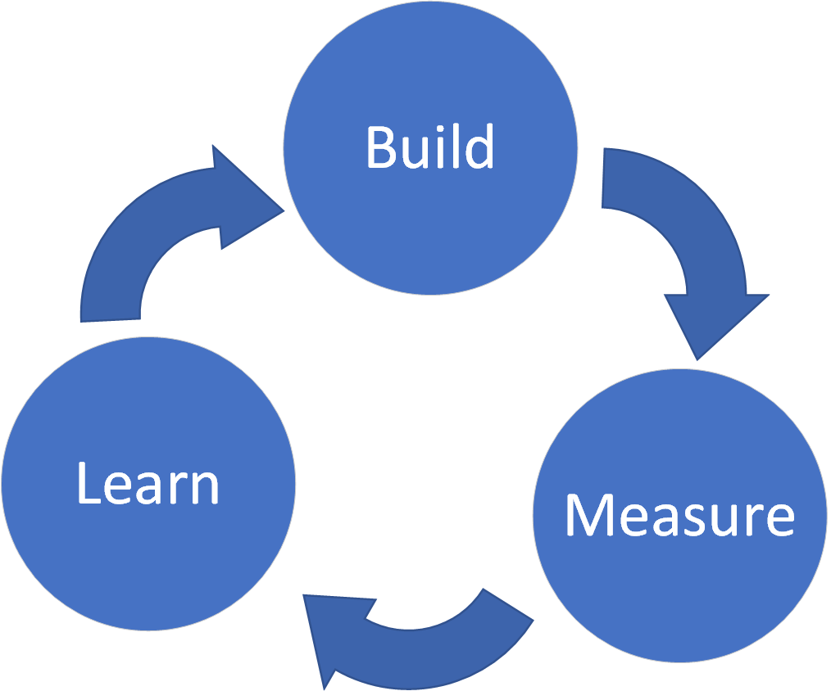
How do you design for cost savings?
Calculate estimate
Gather baseline metrics
Measure and iterate
Repeat

Slide 155
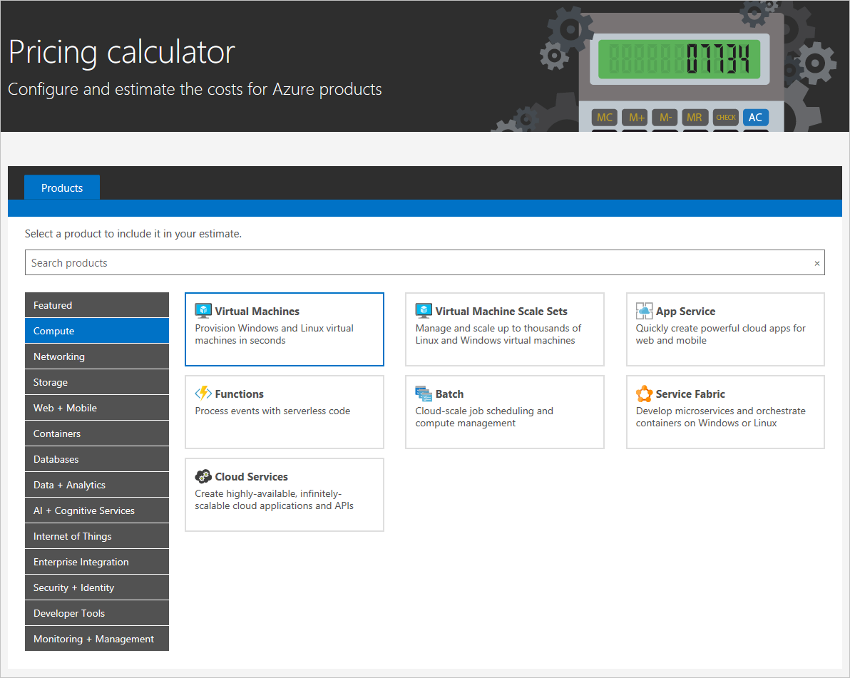
Estimating Costs
Calculate estimates with Azure Price Calculator:
https://azure.microsoft.com/en-us/pricing/calculator/

Slide 156
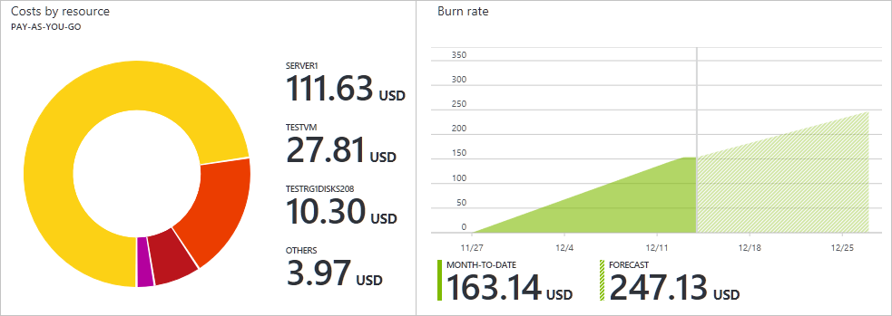
Monitoring Costs
Use resource tags!
Regularly monitor current and projected costs on dashboard

Slide 157
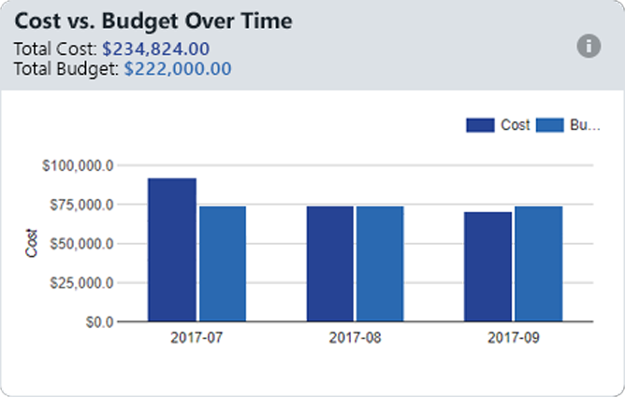
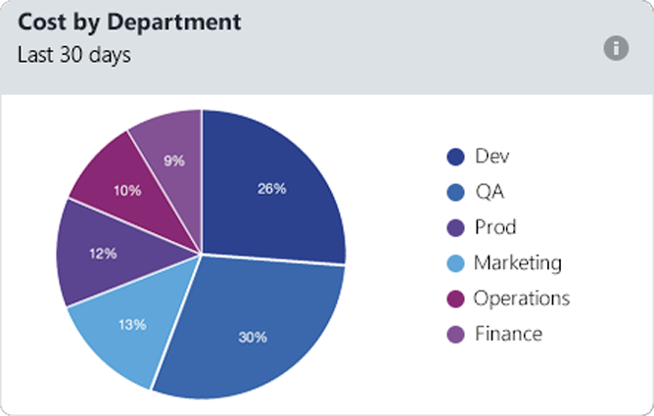
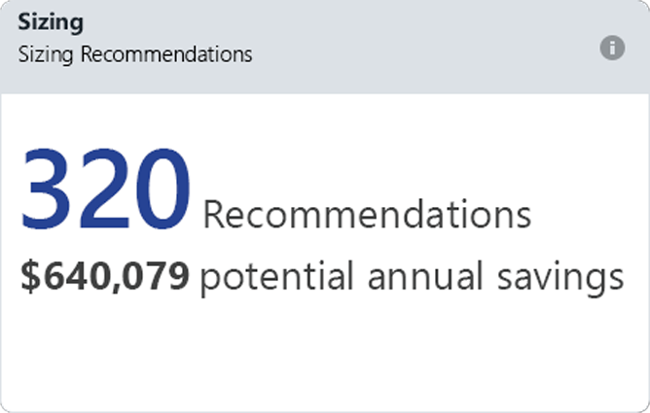
Azure Cost Management
Monitor cloud spend
Drive organizational accountability
Optimize cloud efficiency

Slide 158
Ways to save on costs

Slide 159
Cost savings
VMs:
Use burstable B-Series VMs
Take advantage of reserved pricing
Use preemptible compute
Use Auto-Shutdown
STOP the VM, not just shut down

Slide 160
Cost savings
Use autoscaling to scale DOWN
Scale down based on known schedules
Utilize cloud storage as much as possible
Blob storage is extremely cheap in the cloud
Archive data, move infrequently accessed data
Utilize cold storage
Use containers to maximum application density
Turn on and use Azure Advisor
Use Azure DevTest Labs for non-prod environments
Notes:
People talk about scaling up as being the power of the cloud (infinite scalability!)
NO! The power is scaling down. You didn’t buy the hardware, you’re only rending it

Slide 161
Example

Slide 162
Scenario
The problem to solve:
Files get uploaded throughout the day and need to be processed
Need to transform the data and output to a new directory
In this case, file contains a number and the output file contains the numbers factors

Slide 163
Option 1
Azure VM with Windows Service
Similar to on-prem approach
Host a VM, store files in directory, use a service to watch the directory, process, and output to another directory

Slide 164
Option 1
Variable pricing based on VMs
Redundancy would be required
Cheaper options:
A0 Instance = 1 Core, 0.75 GB RAM, 20 GB Storage = $14.88 / month
A1 Instance = 1 Core, 1.75 GB RAM, 70 GB Storage = $66.96 / month
D1 Instance = 1 Core, 3.5 GB RAM, 50 GB Storage = $104.16 / month
D2 Instance = 2 Cores, 7 GB RAM, 100 GB Storage = $208.32 / month

Slide 165
Option 2
Given
1 minute to process every file
Function uses 128 MB of memory when processing
Result: 53,333 executions per month are free
Can process ~1,709 files a day at no cost for a 31 day month

Slide 166
Option 2
How much does it cost if you go over?
Given same processing time and memory usage
2,000 files / day = 62,000 executions = $1.04 / month
3,000 files / day = 93,000 executions = $4.76 / month
5,000 files / day = 155,000 executions = $12.20 / month
10,000 files / day = 310,000 executions = $30.80 / month

Slide 167
Comparison
Pros of using Azure Functions in this case
Azure functions scale horizontally and run in parallel automatically, so files are processed as they come in and not sequentially
Only need to write the code to process one file, and not the code to manage processing in parallel
Low cost and no server management or maintenance

Slide 168
Comparison
Drawbacks of Azure Functions
Limited to 10 minutes per execution
Less CPU resources on Azure’s Consumption Plan, so processing an individual file could take longer than a standard VM
Can be increased using an App Service Plan, but subject to standard App Service Plan rates

Slide 169
Warning! New Dangers!

Slide 170
Dangers
Serverless cost runaway
One bad line of code can have direct $$$ consequences
Mitigating this requires an App Service Plan, which defeats the purpose of making it serverless
New type of attack: Cost attacks
Steal compute cycles to make money (e.g. Bitcoin mining)
Maliciously run up your bill by saturating expensive operations
Rate limiting is a REQUIREMENT when going serverless

Slide 171
Conclusion

Slide 172
What we covered today
Azure Data Storage
App Service Plans
Container Architecture
Serverless Architecture
Networking
Messaging
Management and Security
Azure APIs and Services

Slide 173
Takeaways
Lots of services | Data, Compute, APIs, etc...
More Than One Way
Easy to Start, Hard to Master

Slide 174
Where to Learn More
Azure Resources
Azure Docs: https://docs.microsoft.com/en-us/azure/
Cloud Patterns: https://docs.microsoft.com/en-us/azure/architecture/patterns/
Free Pluralsight Courses: https://www.pluralsight.com/partners/microsoft/azure
CUNA Resources
Titan Team Repo/Wiki: https://cunamutual.visualstudio.com/SecureCloudEnablement
Azure Cloud MS Teams Site

